Slide 1


Van-Tien Nguyen
12-05-2023

Slide 2

Outline
Executive Summary
Introduction
Methodology
Results
Conclusion
Appendix

Slide 3
Executive Summary
In this project, a subset of the data science methodology is applied. It includes: data collection, data understanding, data preparation, modeling, and evaluation.
Exploration data analysis (EDA) is utilized to investigate the relationship between factors contributing on a launch.
To visualize the data, a dashboard is built with interactive functions.
Classification models which predict if a landing case is success or failed achieve more than 80% accuracy.

Slide 4
Introduction
The commercial space age is here. SpaceX is one of the leading companies in the space travel industry. One factor contributing to the success of SpaceX is that the expense for a rocket launch is inexpensive. SpaceX advertises Falcon 9 rocket launches on its website with a cost of 62 million dollars; other providers cost upwards of 165 million dollars each, much of the savings is because SpaceX can reuse the first stage.
Research on the recorded data from SpaceX can help to explore the main factors in the rocket launch problem.
The ultimate aim of this project is to determine if the first stage will land successfully or not, so that the cost of a launch is estimated precisely.

Slide 5

Section 1

Slide 6
Methodology
Executive Summary
Data collection.
Data wrangling
Exploratory data analysis (EDA) using visualization and SQL.
Interactive visual analytics using Folium and Plotly Dash.
Predictive analysis using classification models.

Slide 7
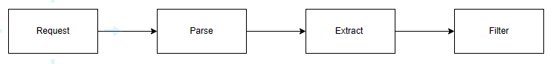
Data Collection – SpaceX API
Dataset is collected from SpaceX API. It contains information of launches in SpaceX company.
By request to SpaceX API, a json-formatted data table is collected and then normalize.
Link to SpaceX API call notebook: IBM-Data-Science-Professional-Certificate/spacex-data-collection-api.ipynb at master · NVTienOfficial/IBM-Data-Science-Professional-Certificate (github.com)
Data collection flowchart:

Slide 8
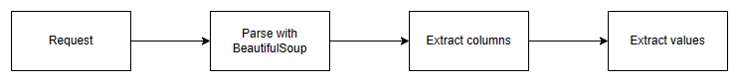
Data Collection – Scrapping
Request to the Wikipedia website (List of Falcon 9 and Falcon Heavy launches) to get html content. The content is parsed with BeautifulSoup into a table-structured format. Only attributes and values in considered range is kept.
Link to Web Scrapping notebook: IBM-Data-Science-Professional-Certificate/webscraping.ipynb at master · NVTienOfficial/IBM-Data-Science-Professional-Certificate · GitHub
Web scrapping flowchart:

Slide 9
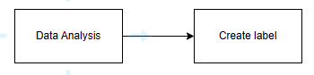
Data Wrangling
Focus on handle missing, NaN values, and create landing outcome as label for prediction task.
Link to Data Wrangling notebook: IBM-Data-Science-Professional-Certificate/data_wrangling.ipynb at master · NVTienOfficial/IBM-Data-Science-Professional-Certificate · GitHub
Data wrangling flowchart:

Slide 10
EDA with Data Visualization
In order to illustrate the relation between attributes (Payload mass, The number of flight, Launch site, Orbit type) for success or fail launches, scatter plot is used to show distribution.
The success rate of landing for each orbit that rockets reach is also visualized by bar chart.
A trend line of the average success rate of landing yearly is also plotted.
Link to EDA with data visualization notebook: IBM-Data-Science-Professional-Certificate/eda-dataviz.ipynb at master · NVTienOfficial/IBM-Data-Science-Professional-Certificate · GitHub

Slide 11
EDA with SQL
Display the names of the unique launch sites in the space mission
Display 5 records where launch sites begin with the string 'CCA'
Display the total payload mass carried by boosters launched by NASA (CRS)
Display average payload mass carried by booster version F9 v1.1
List the date when the first successful landing outcome in ground pad was achieved
List the names of the boosters which have success in drone ship and have payload mass greater than 4000 but less than 6000
List the total number of successful and failure mission outcomes
List the names of the booster versions which have carried the maximum payload mass. Use a subquery
List the records which will display the month names, failure landing outcomes in drone ship ,booster versions, launch site for the months in year 2015.
Rank the count of successful landing outcomes between the date 04-06-2010 and 20-03-2017 in descending order.
Link to EDA with SQL notebook: IBM-Data-Science-Professional-Certificate/eda-sql.ipynb at master · NVTienOfficial/IBM-Data-Science-Professional-Certificate · GitHub

Slide 12
Build an Interactive Map with Folium
Folium map is created with markers, circles and lines representing for launch site, cluster of launch site, and the distance respectively.
The Folium map’s objects show the distribution of launch site’s coordinates and the relative distance with coastlines, railways, highways, and cities.
Link to Interactive map with Folium map notebook: IBM-Data-Science-Professional-Certificate/launch_site_location.ipynb at master · NVTienOfficial/IBM-Data-Science-Professional-Certificate · GitHub

Slide 13
Build a Dashboard with Plotly Dash
The Dashboard focuses on the relationship between launch site, payload mass, and landing outcome. There are two main graphs: pie chart and scatter plot. The pie chart shows the success rate of each launch site. Besides, the scatter plot illustrates the distribution between Payload Mass and Class (success or failed).
User can interact with the dashboard by a dropdown handling the chosen launch site and a range slider setting the focused range of payload mass.
Link to Plotly Dash lab: IBM-Data-Science-Professional-Certificate/spacex_dash_app.py at master · NVTienOfficial/IBM-Data-Science-Professional-Certificate · GitHub

Slide 14
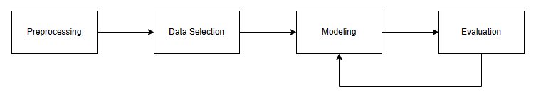
Predictive Analysis (Classification)
Use the sklearn library to build Logistic Regression, Support Vector Machine, Decision Tree, K-Nearest Neighbor models.
To get best configuration of each model, a grid search is applied.
Evaluation methods are accuracy (train, test) and confusion matrix.
Link to Predictive analysis lab: IBM-Data-Science-Professional-Certificate/SpaceX_Machine_Learning_Prediction.ipynb at master · NVTienOfficial/IBM-Data-Science-Professional-Certificate (github.com)
Model development process flowchart:

Slide 15

Section 2

Slide 16
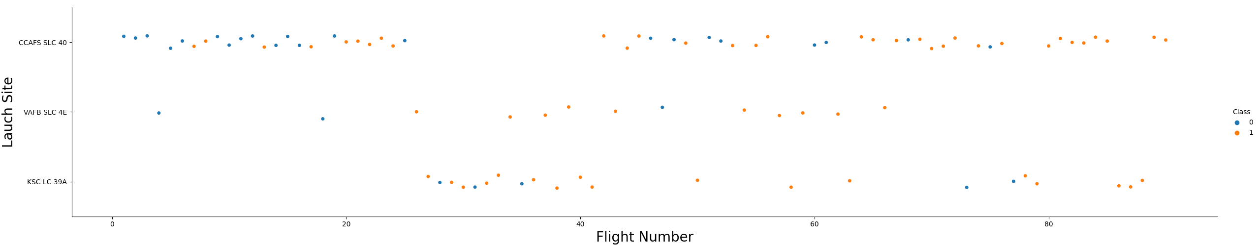
Flight Number vs. Launch Site
Scatter plot of Flight Number vs. Launch Site
When the Flight Number increase the success rate of landing outcome increase.
For the launch site VAFB SLC 4E, the number of success case is almost.

Slide 17
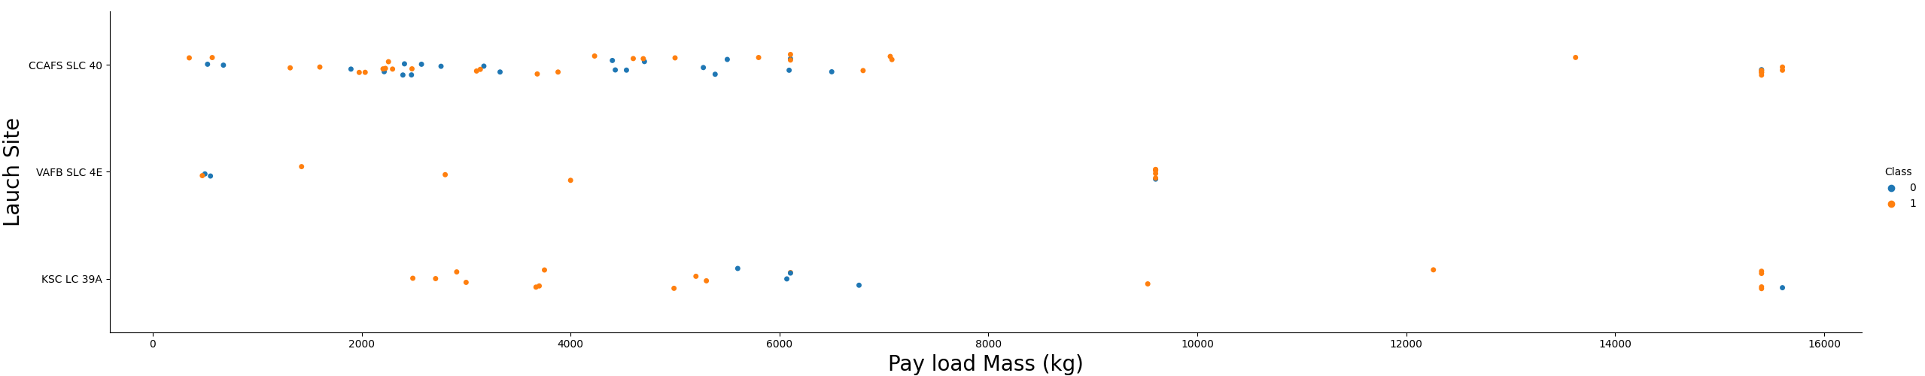
Payload vs. Launch Site
Scatter plot of Payload vs. Launch Site
For the launch site VAFB SLC 4E, the success rate increase when the payload increase.
The success rate for payload which is larger than 8000 kg is approximately 100%.

Slide 18
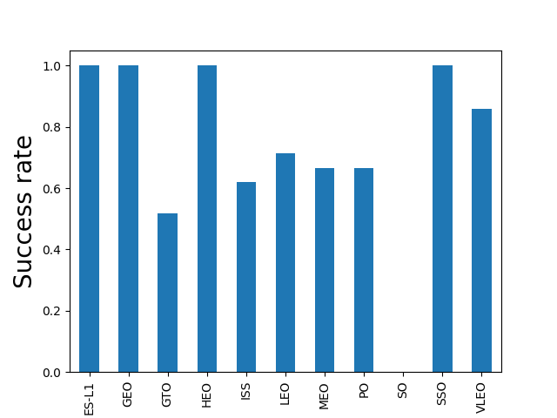
Success Rate vs. Orbit Type
Bar plot of Success Rate vs. Orbit Type:
Four orbit ES-L1, GEO, HEO, and SSO have 100% success rate.
Except SO, the success rate is always higher than 50%.

Slide 19
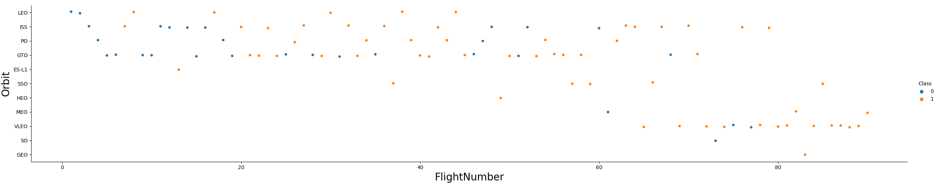
Flight Number vs. Orbit Type
Scatter plot of Flight Number vs. Orbit Type
ISS, PO, and GTO patterns are not detectable.
ES-L1, HEO, and GEO have only 1 case which is success. Besides, SO has only 1 case and it is failed.

Slide 20
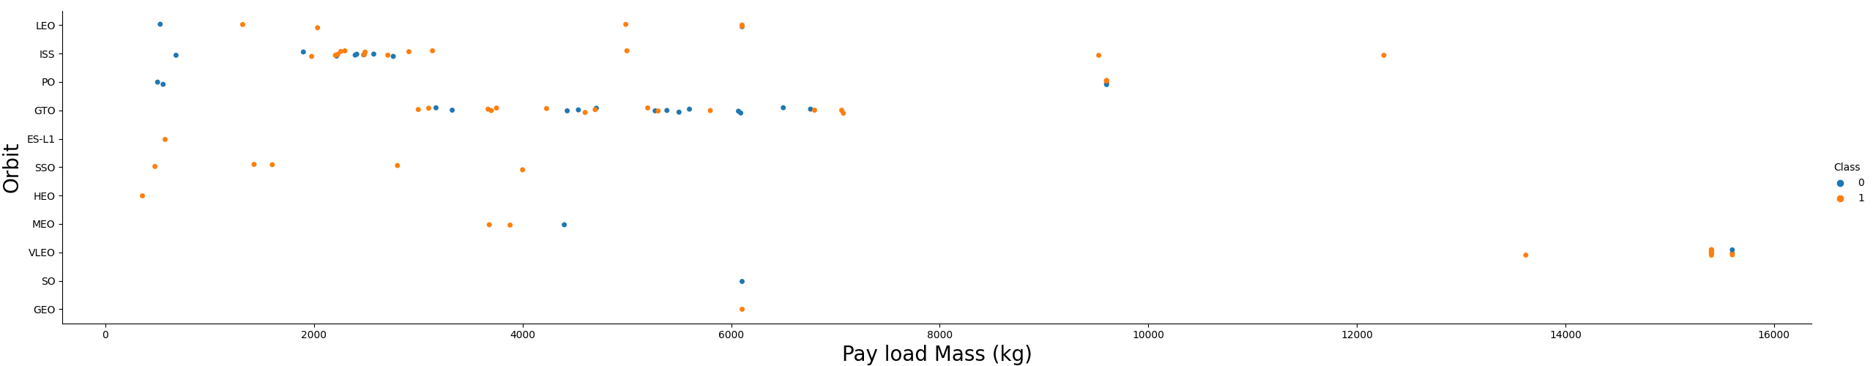
Payload vs. Orbit Type
Scatter plot of Payload vs. Orbit Type
Most of cases have payload mass less than 6000 kg.
There is no significant relation between payload and orbit type.

Slide 21
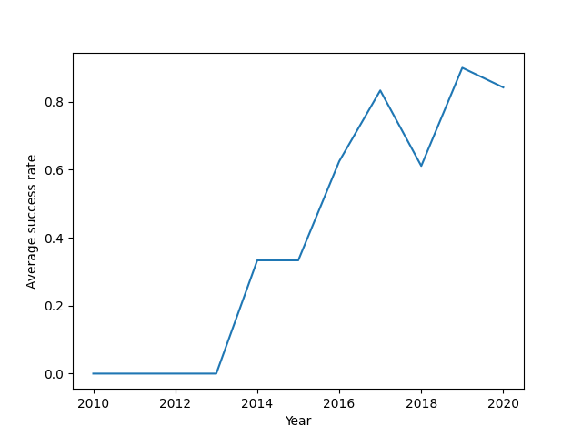
Launch Success Yearly Trend
A line chart of yearly average success rate:
There is an increase trend in yearly average success rate. However, 2018 and 2020 show downward trends.
No success rate in the range between 2010 and 2013.
The yearly average success rate in 2020 is greater than 80%.

Slide 22
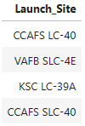
All Launch Site Names
Query: SELECT DISTINCT(Launch_Site) FROM SPACEXTBL

Slide 23
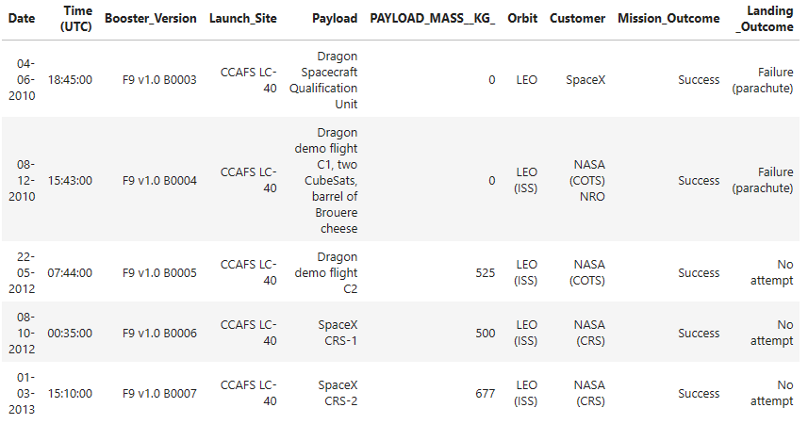
Launch Site Names Begin with 'CCA'
Query: SELECT * FROM SPACEXTBL WHERE Launch_Site LIKE ‘CCA%’ LIMIT 5

Slide 24
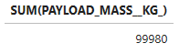
Total Payload Mass carried by boosters from NASA
Query: SELECT SUM(PAYLOAD_MASS_KG_) FROM SPACEXTBL
WHERE Customer LIKE ‘NASA%’

Slide 25
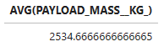
Average Payload Mass by F9 v1.1
Query: SELECT AVG(PAYLOAD_MASS_KG_) FROM SPACEXTBL
WHERE Booster_Version LIKE ‘F9 v1.1%’

Slide 26
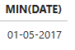
First Successful Ground Landing Date
Query: SELECT MIN(DATE) FROM SPACEXTBL
WHERE “Landing _Outcome” == ‘Success (ground pad)’

Slide 27
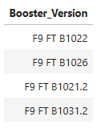
Successful Drone Ship Landing with Payload between 4000 and 6000
Query: SELECT Booster_Version FROM SPACEXTBL
WHERE PAYLOAD_MASS_KG_ > 4000 AND PAYLOAD_MASS_KG_ < 6000
AND “Landing _Outcome” == ‘Success (drone ship)’

Slide 28
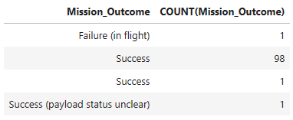
Total Number of Successful and Failure Mission Outcomes
Query: SELECT Mission_Outcome, COUNT(Mission_Outcome) FROM SPACEXTBL
GROUP BY Mission_Outcome

Slide 29
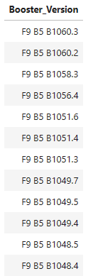
Boosters Carried Maximum Payload
Query: SELECT Booster_Version FROM SPACEXTBL
WHERE PAYLOAD_MASS_KG_ = (
SELECT MAX(PAYLOAD_MASS_KG_) FROM SPACEXTBL
)
ORDER BY Booster_Version DESC

Slide 30
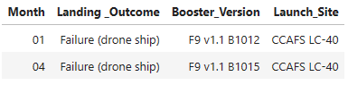
2015 Failed Launch Records
Query: SELECT substr(DATE, 4, 2) AS Month, “Landing _Outcome”, Booster_Version, Launch_Site
FROM SPACEXTBL
WHERE substr(DATE, 7, 4) = ‘2015’
AND “Landing _Outcome” = ‘Failure (drone ship)’

Slide 31
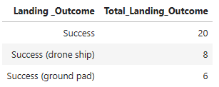
Rank Landing Outcomes Between 2010-06-04 and 2017-03-20
Query: SELECT “Landing _Outcome”,
COUNT(“Landing _Outcome”) AS Total_Landing_Outcome
FROM SPACEXTBL
WHERE “Landing _Outcome” LIKE ‘Success%’
AND DATE BETWEEN ’04-06-2016’ AND ’20-03-2017’
GROUP BY “Landing _Outcome”
ORDER BY “Landing _Outcome” DESC

Slide 32

Section 3

Slide 33
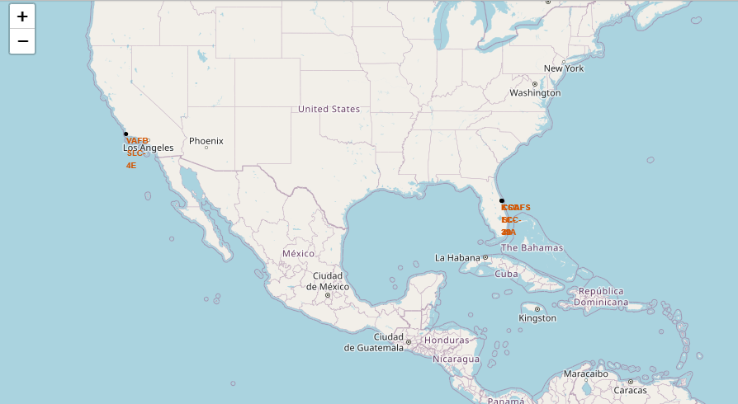
Folium Map: All launch site’s location markers
The launch sites are placed in America near coastlines.

Slide 34
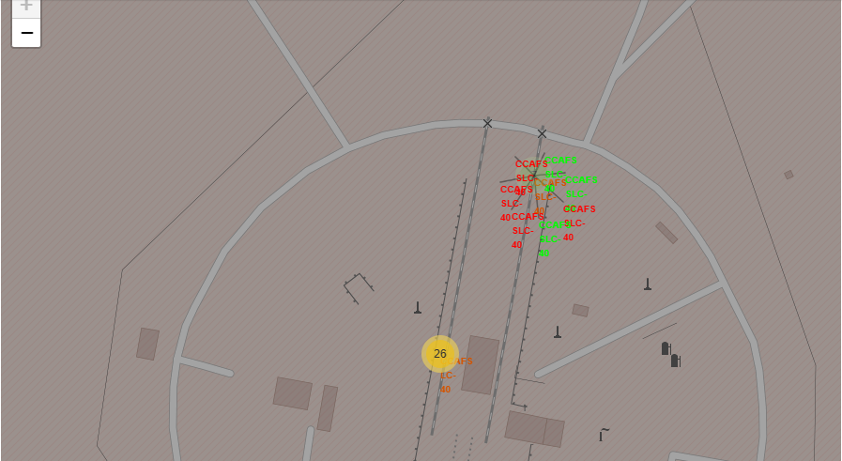
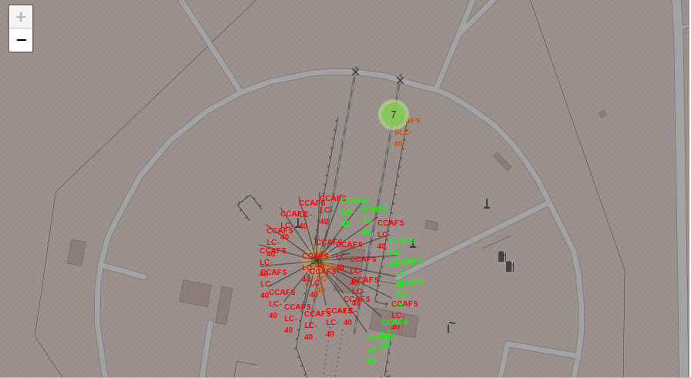
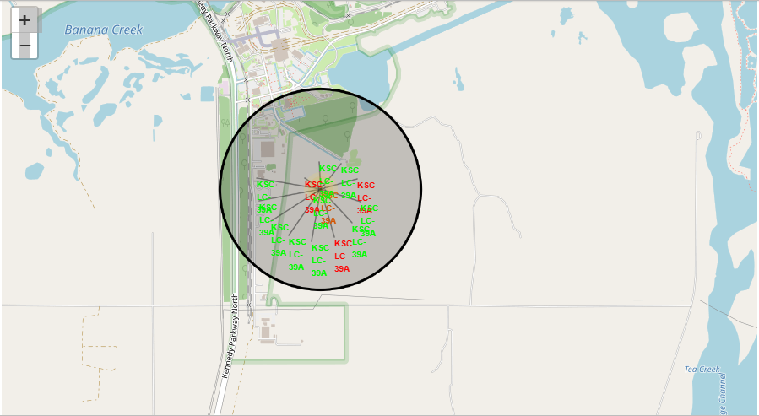
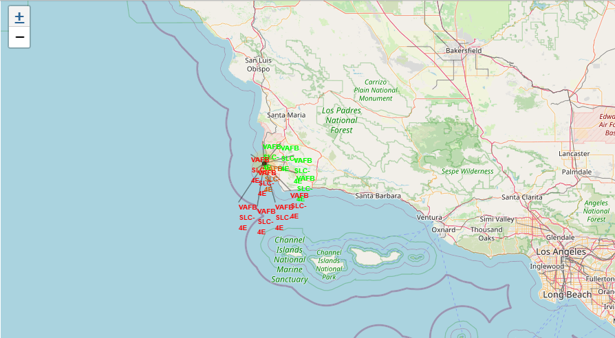
Folium Map: Launch site with landing outcome
The success site is annotated with green, and red for failed one.
KSC LC-39A is the launch site with high rate of success.

Slide 35
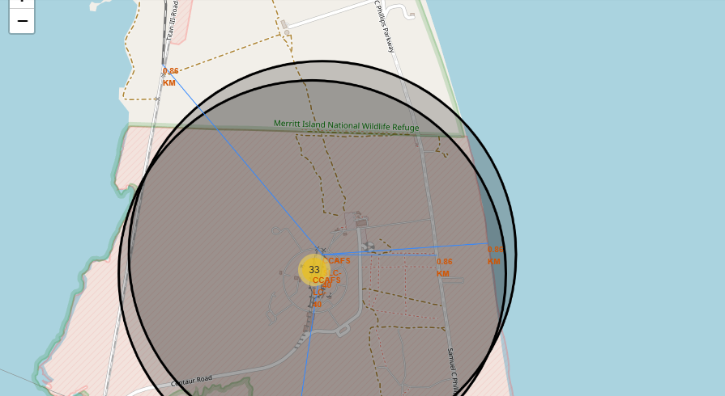
Folium Map: Proximites
Four proximities: coastline, railway, highway, and city.
The launch site is near with coastline, railway, and highway for easy transportation. However, it is kept far from city because of the side effects.

Slide 36

Section 4

Slide 37
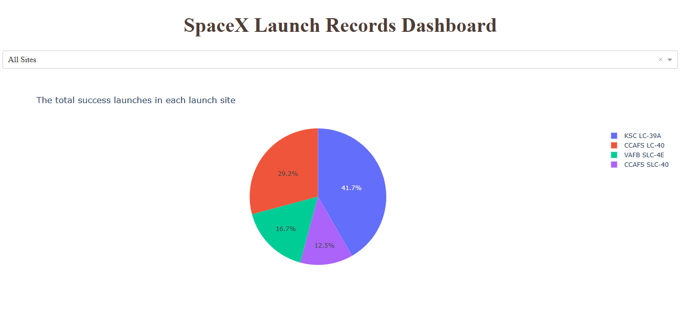
Dashboard: Total launch success count for all sites
KSC LC-39A has the highest proportion of launch success, 41.7%.
CCAFS SLC-40 has the lowest percentage of launch success, 12.5%.

Slide 38
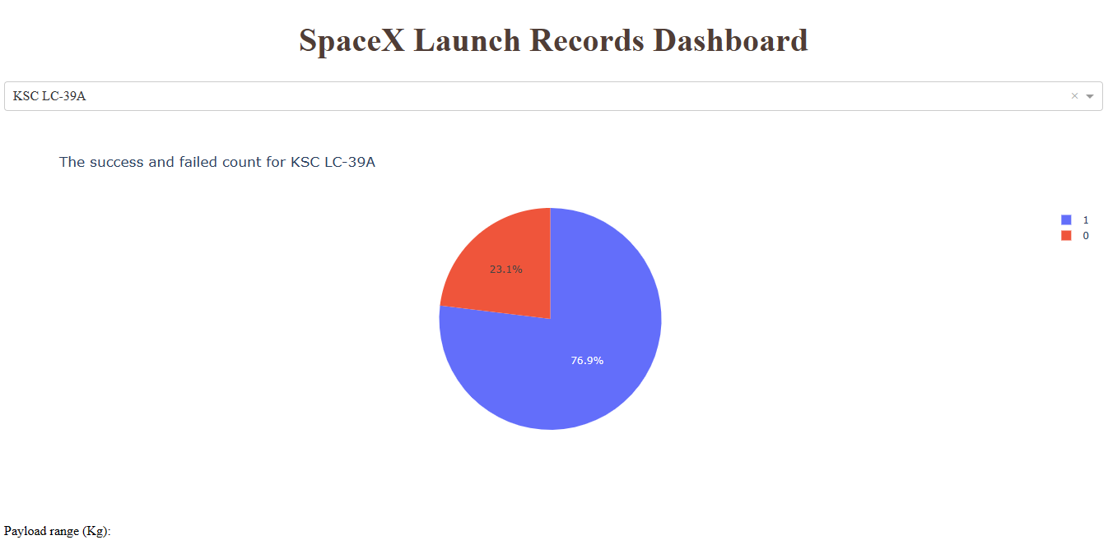
Dashboard: The launch success ratio for KSC LC-39A
10 success cases which equal to 76.9% success rate.

Slide 39
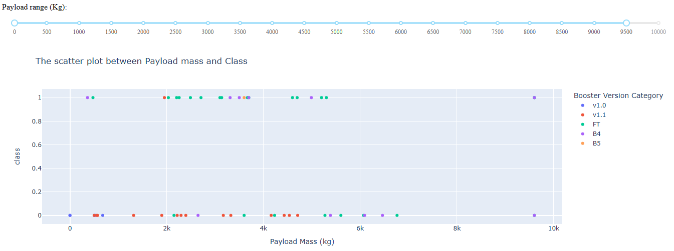
Dashboard: Scatter plot Payload vs. Launch Outcome for all sites
Success landing cases concentrate on the payload mass range between 2000 and 4000 kg, and with two main booster version (FT, B4).
Most of failed landing cases belong to the booster version v1.1 with payload mass less than 5000 kg.

Slide 40

Section 5

Slide 41
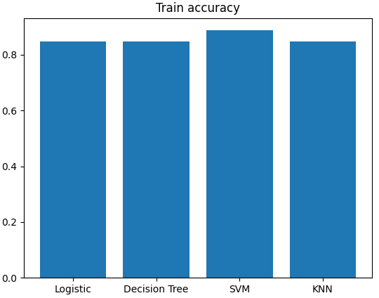
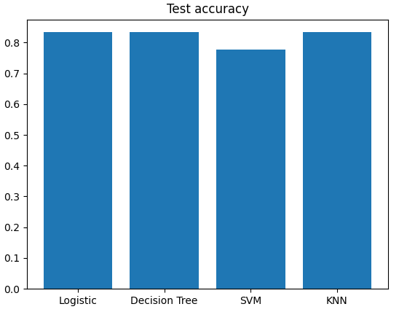
Classification Accuracy
SVM show better performance on the train set, but the worst one on the test set.
The highest test accuracy is 83.3% for Logistic Regression, Decision Tree, and K-Nearest Neighbors.

Slide 42
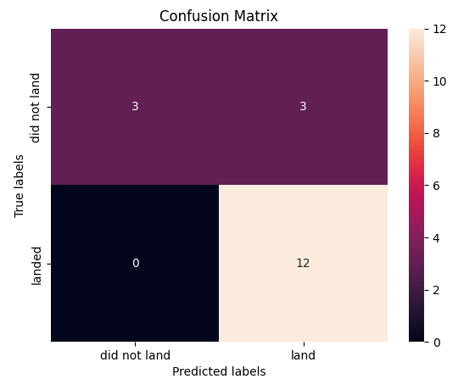
Confusion Matrix
The confusion matrice for Logistic Regression, Decision Tree, and K-Nearest Neighbors classifiers are the same.
There are 3 failed landing cases which are predicted as successful.

Slide 43
Conclusions
It is possible to determine the landing outcome of a rocket launch by available information.
The launch site is important for the success rate of landing.
To improve the predictive results, a deep analysis into attributes, model architecture is needed.

Slide 44


